Slide 1
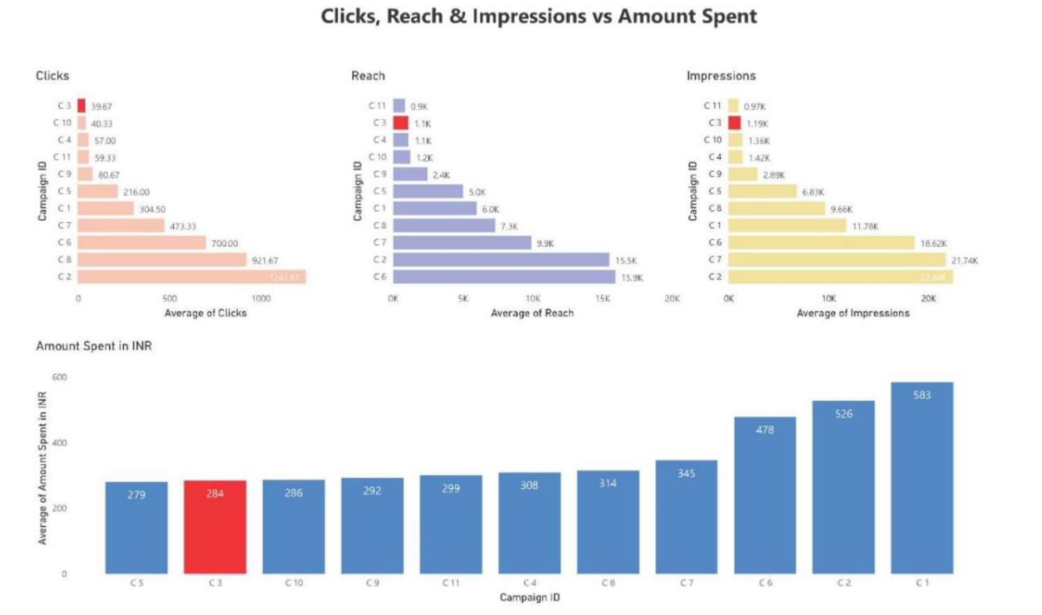

Slide 2
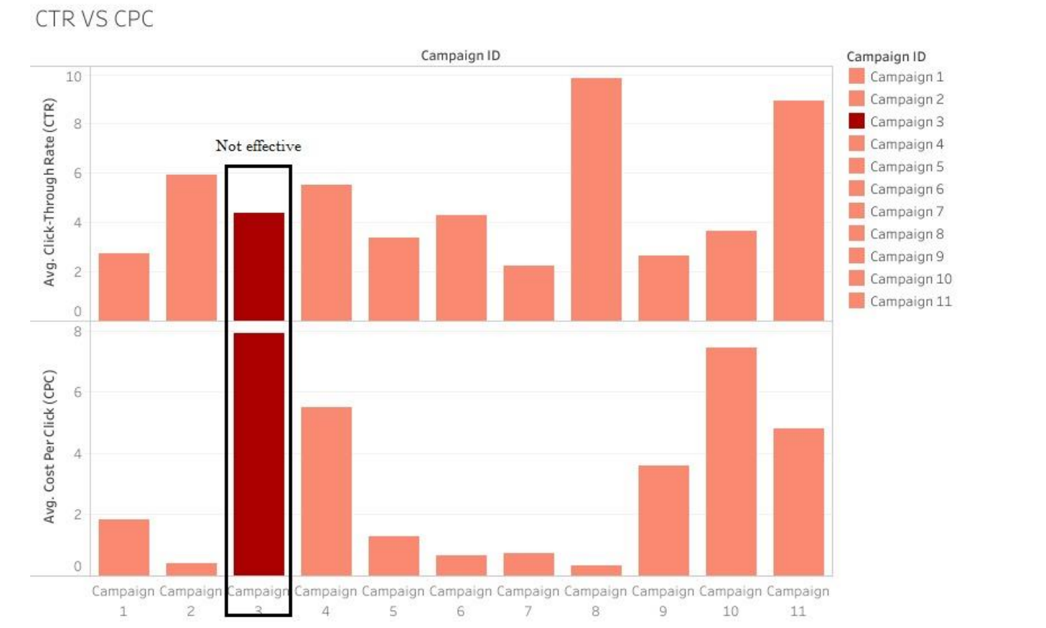

Slide 3
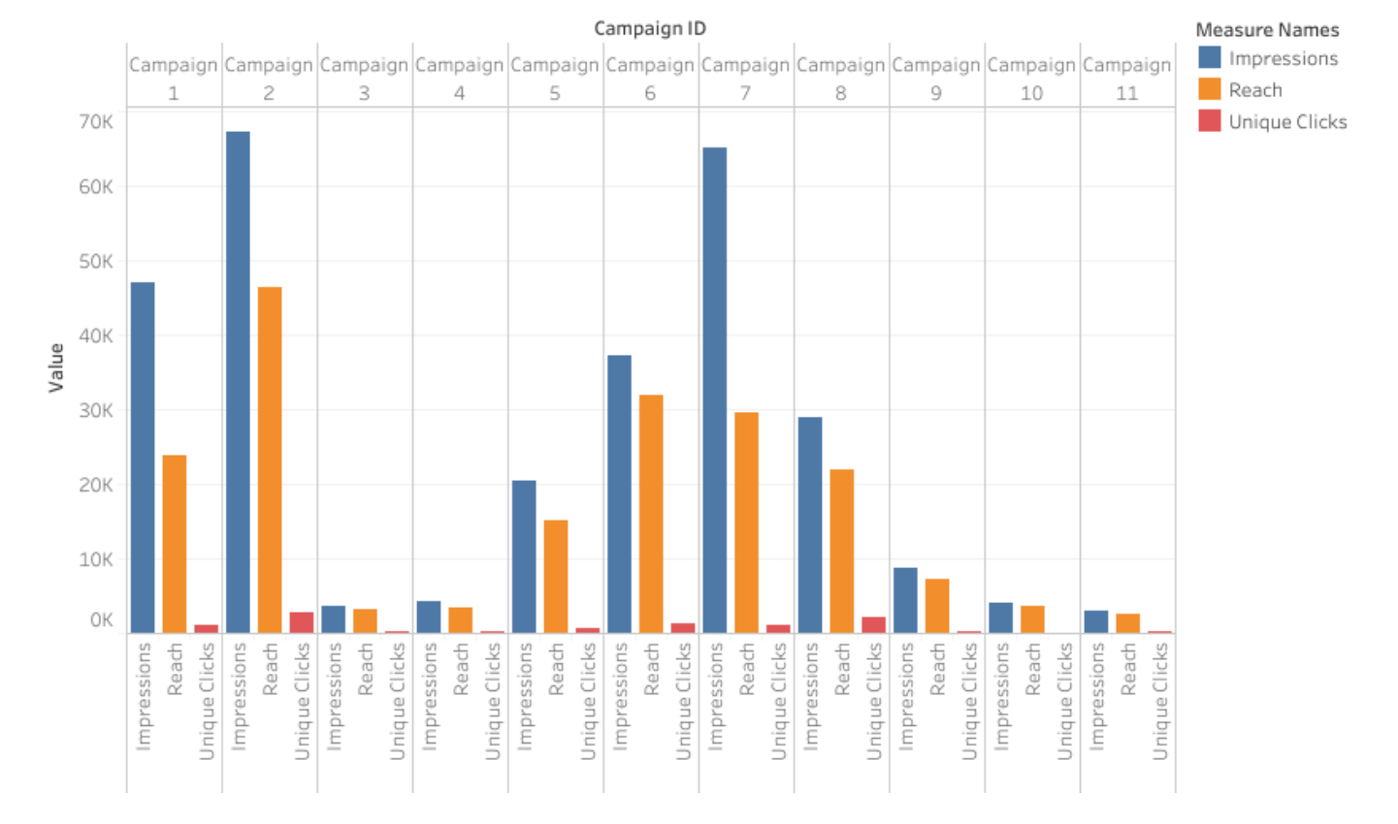

Slide 4
CONCLUSION
1. After analyzing the dataset given to us, we can comprehend that there are several factors which we can be considered to decide whether to continue a particular campaign or not.
2. After a brief discussion we have decided that the most important factors to be considered for discontinuing a campaign are Reach, Clicks, Impressions, Amount spent in INR, and Unique Clicks.
3. After visualizing and comparing the results, we came to a conclusion that Campaign 3 is having the lowest number of reaches and impressions, while also having a higher amount spent. Therefore, Campaign 3 can be considered for removal due to their low result and cost efficiency.

